Slide 1
Potential Due to a Point Charge

Slide 2
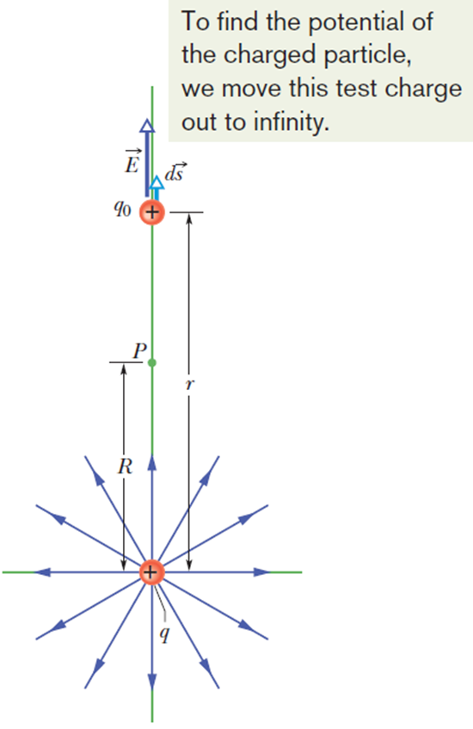
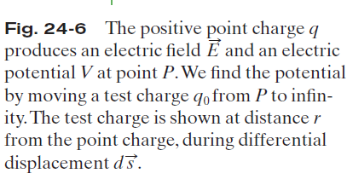
Potential Due to a Point Charge:
A positively charged particle produces a positive electric potential. A negatively charged particle produces a negative electric potential.

Slide 3





Potential Due to a Point Charge:
Consider a point P at distance R from a fixed particle of positive charge q. Imagine that we move a positive test charge q₀ from point P to infinity. The path chosen can be the simplest one— a line that extends radially from the fixed particle through P to infinity.
If V_{f} =0 (at ∞) and V_{i} =V (at R). Then, for the magnitude of the
electric field at the site of the test charge,
That gives:
Switching R to r,

Slide 4
Potential Due to a Point Charge:
Consider a point P at distance R from a fixed particle of positive charge q. Imagine that we move a positive test charge q₀ from point P to infinity. The path chosen can be the simplest one— a line that extends radially from the fixed particle through P to infinity.
If V_{f} =0 (at ∞) and V_{i} =V (at R). Then, for the magnitude of the electric field at the site of the test charge,

Slide 5
Potential Due to a Point Charge
Switching R to r,

Slide 6
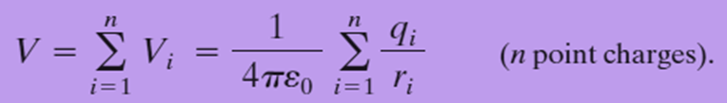
Potential Due to a Group of Point Charges:
The net potential at a point due to a group of point charges can be found with the help of the superposition principle. First the individual potential resulting from each charge is considered at the given point. Then we sum the potentials.
For n charges, the net potential is

Slide 7
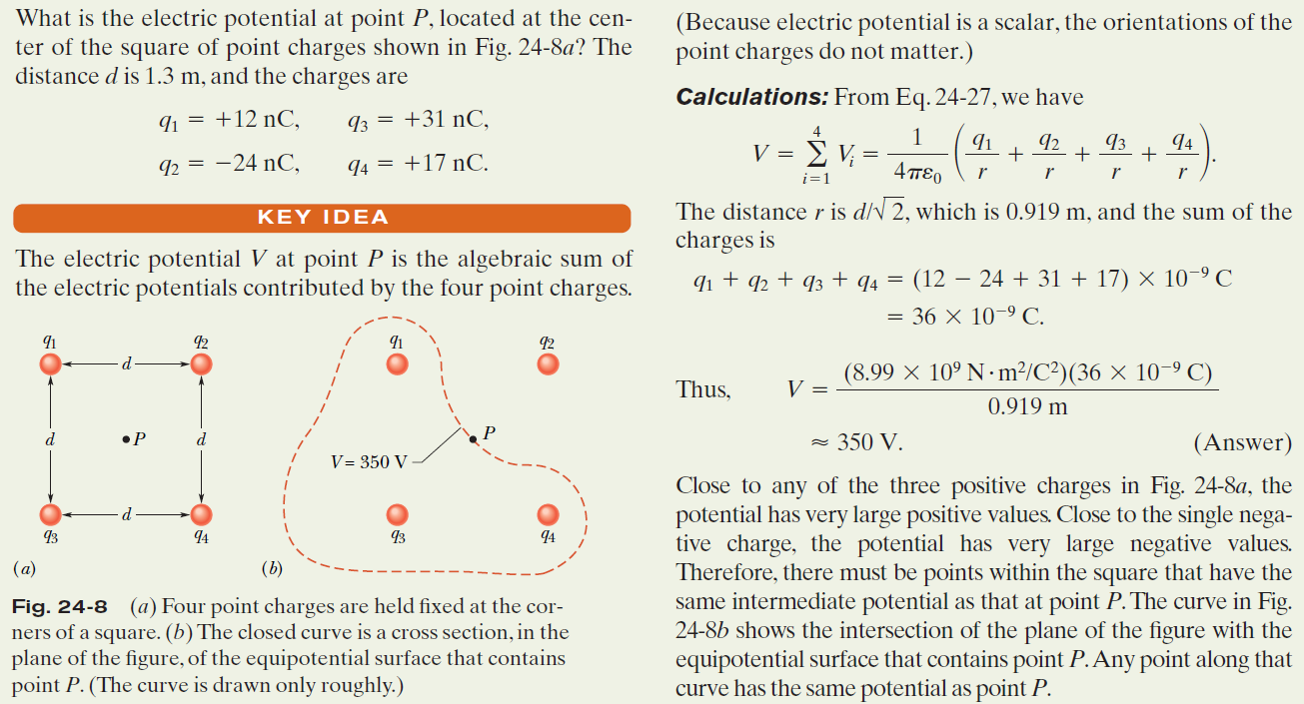
Example, Net Potential of Several Charged Particles:

Slide 8
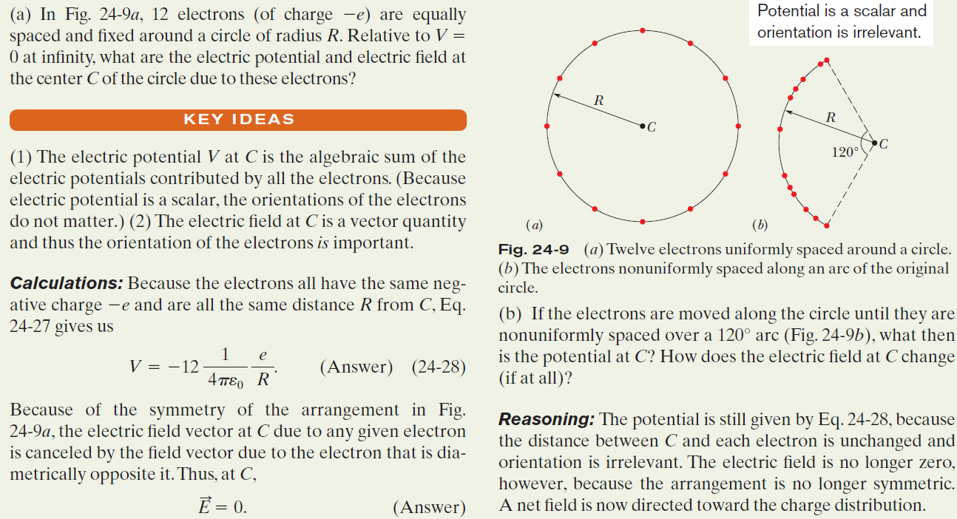
Example, Potential is not a Vector:

Slide 9
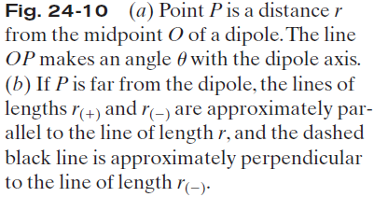
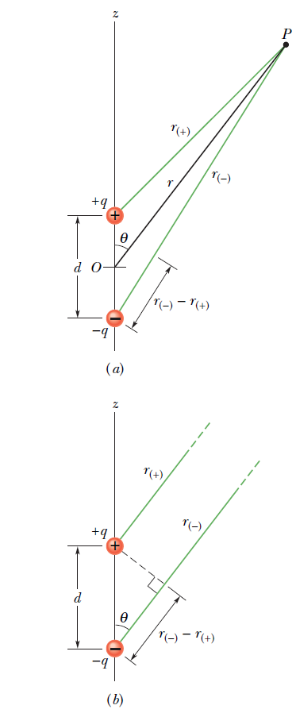
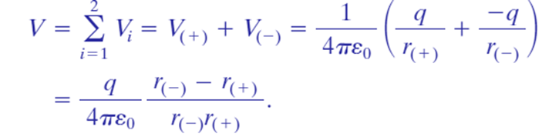

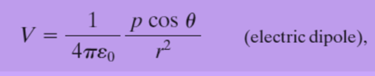
24.8 Potential Due to an
Electric Dipole:
At P, the positive point charge (at distance r₍₊₎) sets up potential V₍₊₎ and the negative point charge (at distance r₍₋₎) sets up potential V₍₋₎.Then the net potential at P is:
Naturally occurring dipoles are quite small; so we are usually interested only in points that are relatively far from the dipole, such that d«r, where d is the distance between the charges. If p = qd,

Slide 10
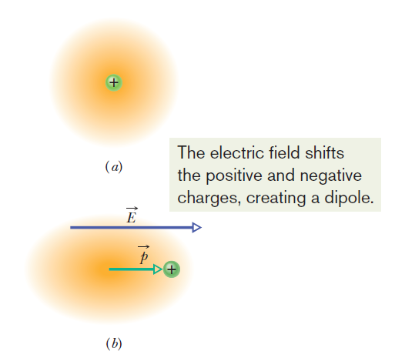
24.8 Induced Dipole Moment:
Fig. 24-11 (a) An atom, showing the positively charged nucleus (green) and
the negatively charged electrons (gold shading).The centers of positive and
negative charge coincide. (b) If the atom is placed in an external electric field E,
the electron orbits are distorted so that the centers of positive and negative charge
no longer coincide. An induced dipole moment p appears. The distortion is
greatly exaggerated here.

Slide 11
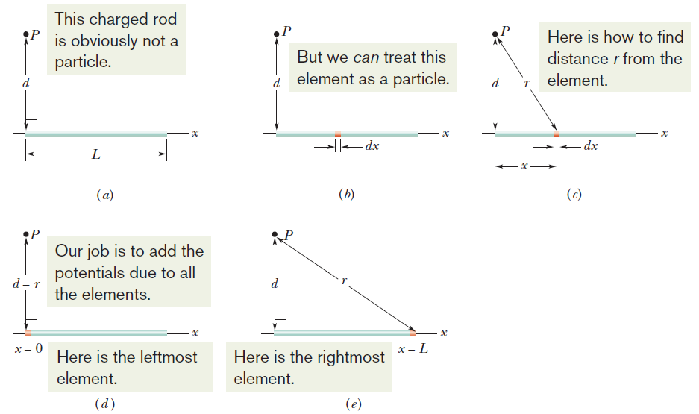


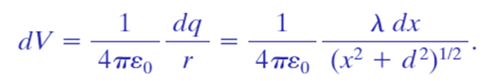
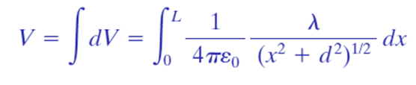
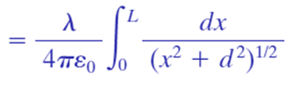
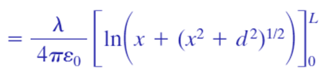

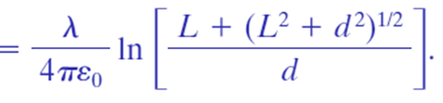
24.9 Potential Due to a Continuous Charge Distribution: Line of Charge:
Fig. 24-12 (a) A thin, uniformly charged rod produces an electric potential V at point P. (b) An element can be treated as a particle. (c) The potential at P due to the element depends on the distance r. We need to sum the potentials due to all the elements, from the left side (d) to the right side (e).
If λ is the charge per unit length, then the charge on length dx is:

Slide 12
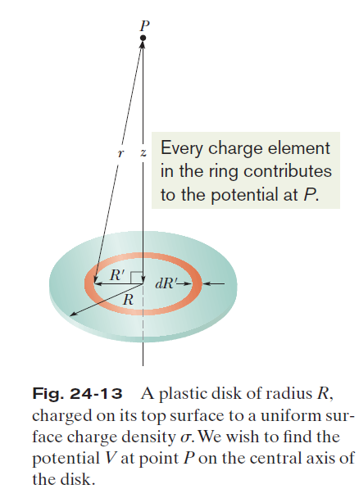



24.9 Potential Due to a Continuous Charge Distribution: Charged Disk:
In Fig. 24-13, consider a differential element consisting of a flat ring of radius R’ and radial width dR’. Its charge has magnitude
The contribution of this ring to the electric potential at P is:
The net potential at P can be found by adding (via integration) the contributions of all the rings from R’=0 to R’= R:

Slide 13
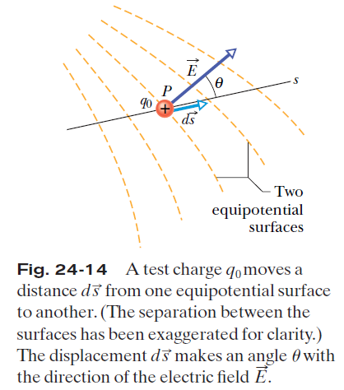





24.10 Calculating the Field from the Potential:
Suppose that a positive test charge q₀ moves through a displacement from one equipotential surface to the adjacent surface. The work the electric field does on the test charge during the move is -q₀ dV.
The work done by the electric field may also be written as the scalar product or =q₀E(cos θ) ds.
Therefore,
That is,
Since E cos θ is the component of E in the direction of ds,
If we take the s axis to be, in turn, the x, y, and z axes, the x, y, and z components of E at any point are
Therefore, the component of E in any direction is the negative of the rate at which the electric potential changes with distance in that direction.

Slide 14
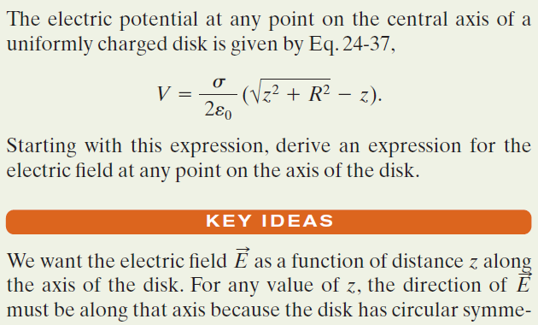
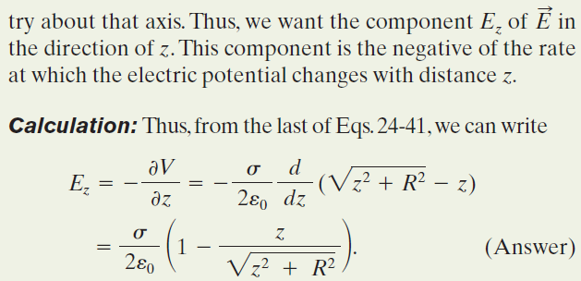
Example, Finding the Field from the Potential:

Slide 15
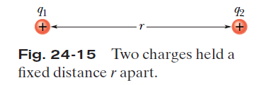


24.11 Electric Potential Energy of a System of Point Charges:
The electric potential energy of a system of fixed point charges is equal to the work that must be done by an external agent to assemble the system, bringing each charge in from an infinite distance.
Figure 24-15 shows two point charges q₁ and q₂, separated by a distance r. When we bring q₁ in from infinity and put it in place, we do no work because no electrostatic force acts on q₁. However, when we next bring q₂ in from infinity and put it in place, we must do work because q₁ exerts an electrostatic force on q₂ during the move.
The work done is q₂V, where V is the potential that has been set up by q₁ at the point where we put q₂.

Slide 16
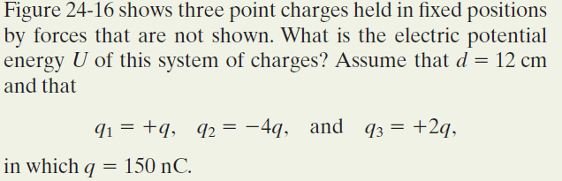
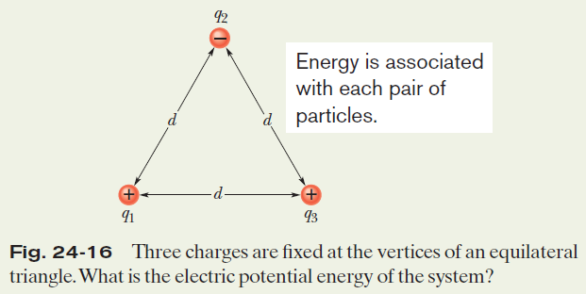
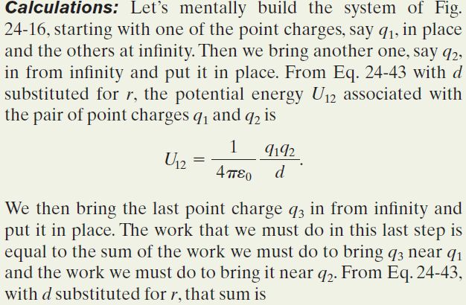
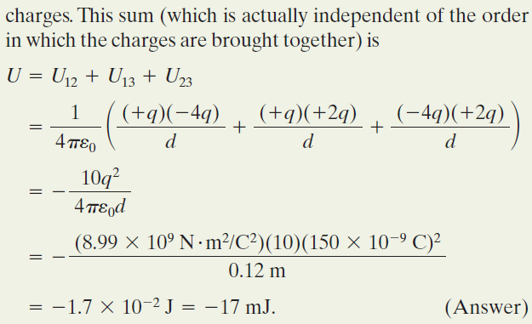
Example, Potential Energy of a System of Three Charged Particles:

Slide 17
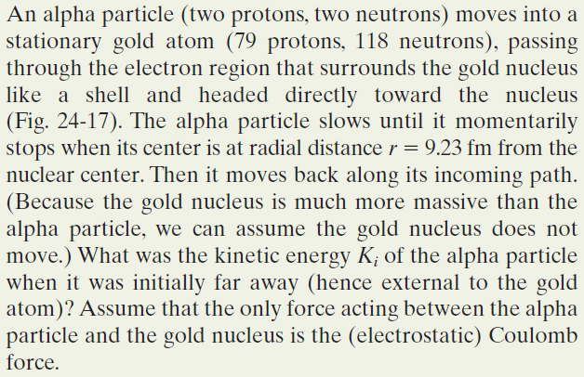
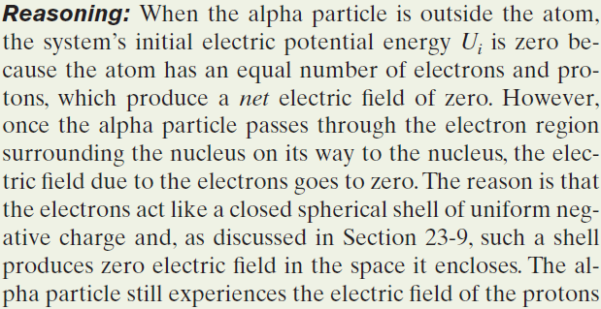
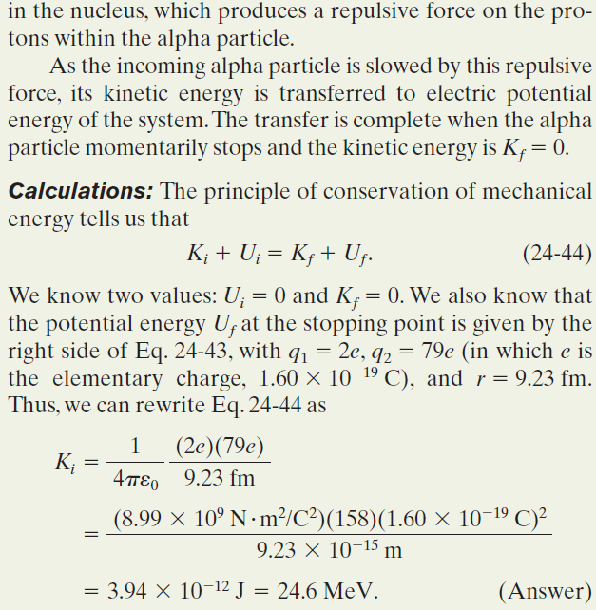
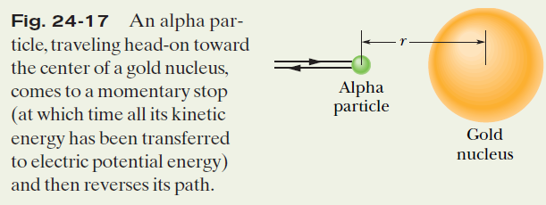
Example, Conservation of Mechanical Energy with Electric Potential Energy:

Slide 18
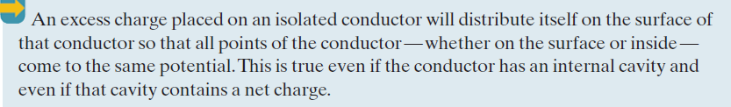

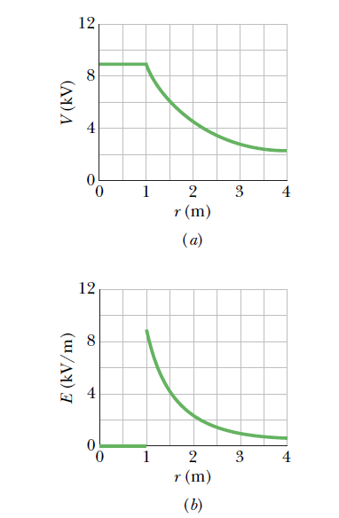
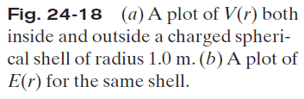
24.12 Potential of a Charges, Isolated Conductor:
We know that
Since for all points E = 0 within a conductor, it follows directly that
V_{f} =V_{i} for all possible pairs of points i and f in the conductor.

Slide 19
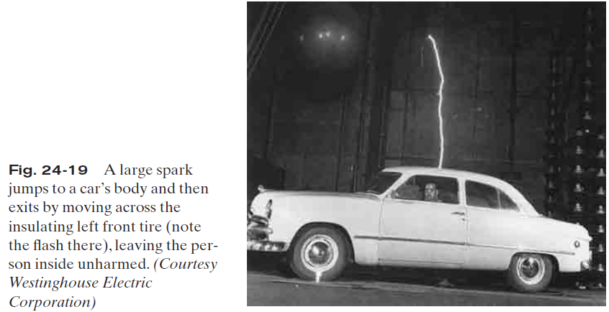
24.12 Spark Discharge from a Charge Conductor:
On nonspherical conductors, a surface charge does not distribute itself uniformly over the surface of the conductor. At sharp points or edges, the surface charge density—and thus the external electric field, —may reach very high values. The air around such sharp points or edges may become ionized, producing the corona discharge that golfers and mountaineers see on the tips of bushes, golf clubs, and rock hammers when thunderstorms threaten. Such corona discharges are often the precursors of lightning strikes. In such circumstances, it is wise to enclose yourself in a cavity inside a conducting shell, where the electric field is guaranteed to be zero. A car (unless it is a convertible or made with a plastic body) is almost ideal

Slide 20
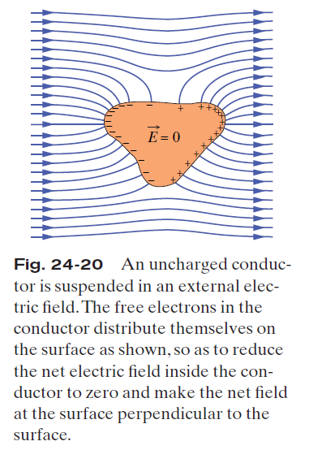
24.12 Isolated Conductor in an Isolated Electric Field:
If an isolated conductor is placed in an external electric field, all points of the conductor still come to a single potential regardless of whether the conductor has an excess charge.
The free conduction electrons distribute themselves
on the surface in such a way that the electric field they produce at interior points cancels the external electric field that would otherwise be there.
Furthermore, the electron distribution causes the net electric field at all points on the surface to be perpendicular to the surface. If the conductor in Fig. 24-20 could be somehow removed, leaving the surface charges frozen in place, the internal and external electric field would remain absolutely unchanged.

